Slide 1


STOCK PRICE MOVEMENT DETECTION USING CANDLESTICK PATTERNS
IV Year B.Tech II Semester– Major Project Review
Team Members Details
KATTA SHIVANI 20N31A6927
L. SREENIVAS REDDY 20N31A6933
Y.SUDHARSHAN REDDY 20N31A6959
IV Year B.Tech – CSE (IOT)
Under the Guidance of
Dr. M. Gayatri
Professor
Department of Emerging Technologies

Slide 2
Outline
Abstract
Introduction
Existing System
Proposed System
Difference between Existing and Proposed
Literature Review
Architectural Diagram
Technical Requirement Specification
Output Screens
Conclusion And Future Scope

Slide 3
Abstract
Stock Market forecasting is a knotty challenging task due to the highly noisy, nonparametric, complex and chaotic nature of the stock price time series. Since stock prices vary dramatically, it is important to determine when to buy and sell stocks in order to get high returns from stock investment.
Predicting the direction of speak price movements is a challenging task, as the stock market is influenced by a wide range of complex and interconnected factors. The aim of stock prediction is to effectively predict future stock market trends, which can lead to increased profit. One major stock representation of the price action over a set period of time. In this we propose using a convolution neural network (CNN) machine learning model, implemented with TensorFlow and Keras, to predict the direction of stock price movements using candlestick chart data.
The use of a CNN model allows for the analysis of the visual patterns present in the candlestick charts, which may not be easily discernible to the human eye. However, implementing a machine learning model for this task is not without its

Slide 4
challenges. Some potential difficulties that may arise include: Limited data availability, Complexity of stock market data, Overfitting. Short-term fluctuations.
Overall, using a CNN machine learning model with TensorFlow and Keras to predict the directions of stock price movements using candlestick chart data.

Slide 5
Introduction
Investing is popular for generating profits. Conservative investors put money in banks, funds or stocks for interest and dividends. Active investors buy and sell stocks, futures, and options for higher returns.
Although stock investment can yield high profitability, the market is affected by macroeconomic factors, international events, stock market volatility, and government policies, making it difficult to predict with accuracy. Despite the risk, stock investment remains popular due to its potential for high returns.
Stock prediction aims to analyze available stock market information to effectively predict future trends and increase profits.

Slide 6
Two primary methods are used to support investment decisions:
1. Fundamental analysis
2. Technical analysis.
Fundamental analysis involves analyzing a company's financial data to determine its fair value and forecast future stock value.
Technical analysis is based on examining past stock price movements to predict future trends.
Candlestick chart patterns, a type of technical analysis, provide short-term predictions for traders. Dozens of candlestick chart patterns are identified as signals of bullish/bearish reversals and continuations.

Slide 7
Existing System
The existing systems for stock price movement detection are diverse, with various approaches and technologies used to analyze and predict stock price movements. The system collects historical and real-time stock price data from various sources such as stock exchanges, financial news websites, APIs (e.g., Yahoo Finance, Alpha Vantage), and data providers.
Raw data is preprocessed to clean and transform it into a suitable format for analysis. Preprocessing steps may include handling missing data, removing outliers, and adjusting for stock splits and dividends.
In this existing system there is stock price movement detection only by scatter plot, line plot,
Histogram, heatmap, and confusion matrix.

Slide 8
Proposed System
A theoretically proposed system for stock price movement detection using candlestick patterns would be designed to identify and predict price movements in financial markets based on the analysis of candlestick patterns.
In our project we developed stock price movements detection using candlestick patterns where those candlestick patterns are generated using scatter plot, line plot, histogram, heatmap and confusion matrix.
So, the previous year stocks are all detected by candlestick patterns where all these scatter plot, line plot, histogram, heatmap and confusion matrix will be analyzed by convolution neural network and at last the pattern is generated which is very easy to the stake holders.

Slide 9
Existing Vs Proposed System
Existing system | Proposed System
1. The existing system primarily uses traditional analysis techniques like scatter plots and histograms. | 1. The proposed system emphasizes the use of candlestick patterns and involves the application of CNN.
2.It collects data and processes data from various sources for analysis. | 2.It generates candlestick patterns from different types of plots and matrices.
3. The existing system uses a general techniques. | 3. The proposed system focus on candlestick patterns and stock price movement detection.
4. Assumes the effectiveness of chosen visualization. | 4. Assumes the value of candlestick patterns.
5. Relies on scatter plots, line plots, histograms and heatmaps. | 5. Introduces the analysis of candlestick patterns

Slide 10
Literature Review
S.No | Paper Title,Authors & Publication Details | Algorithm/Techniqe Used | Advantages | Limitations
1 | Predicting Stock Price Movement with Candlestick Patterns by Shih-Chuan Tsai and Jui-Kuei Chen (2010) | Support vector machines (SVM) and neural networks. | Visual Interpretation, Historical Significance, Pattern Recognition. | Subjectivity, False Signals, Limited Predictive Power.
2 | A Novel Approach for Stock Price Movement Prediction Using Candlestick Patterns" by Eman Saad, Walid Abdelmoez, and Nashwa El-Bendary (2015) | Genetic Algorithm (GA) | Incorporation of Candlestick Patterns, Feature Selection Technique, Validation with Real-world Data. | Limited Predictive Power, Dependency on Historical Data, Complexity and Interpretability.
3 | Predicting Stock Price Movement Using Candlestick Patterns and Support Vector Machines" by Ming-Hui Wen and Fu-Rong Chen (2017) | Support vector machines (SVM) | Non-linear Decision Boundaries, Robustness to Overfitting, Effective with High Dimensionality. | Sensitivity to Hyperparameters, Limited Interpretability, Computationally Intensive.

Slide 11
S.No | Paper Title,Authors & Publication Details | Algorithm/Techniqe Used | Advantages | Limitations
4 | Stock Price Movement Prediction Using Technical Indicators and Machine Learning Algorithms by Savita Gupta and Sangeeta Mittal (2019) | Random Forest, Decision Tree, K-Nearest Neighbors (KNN) and Logistic Regression. | Improved Prediction Accuracy, Robustness, Incorporating Market Psychology. | Complexity and Overfitting, Computational Resources, Interpretability Challenges .
5 | A Hybrid Deep Learning Model for Stock Price Movement Prediction by Xin Zhang, Chao Zhang, and Jian Zhang (2020) | recurrent neural networks (RNNs) and long short-term memory networks (LSTMs). | Enhanced Prediction Accuracy, Feature-rich Representation, Robustness to Data Variability . | Complexity and Computational Overhead, Interpretability Challenges, Dependency on Feature Engineering
6 | Enhanced Stock Price Prediction Using Technical Analysis Indicators and Machine Learning by Manish Kumar and Sanjay Jasola (2021) | Random Forest, Decision Trees, Gradient Boosting Machines (GBM) and Logistic Regression. | Holistic Approach, Improved Predictive Accuracy, Real-World Validation. | Data Complexity, Model Overfitting, Subjectivity in Sentiment Analysis.

Slide 12
System Architecture

Slide 13
System Architecture
Online sources publishing stock price
Trained Model
Preprocessing Data
Classification/ Prediction
Online sources publishing financial news
Stock Price

Slide 14
Technical Requirements Specifications

Slide 15
Software Requirement Specifications
Operating System: Recent Versions of Windows or Mac
Python Libraries: Pandas, Keras, Matplotlib, TensorFlow.
IDE: Visual Studio
Python3

Slide 16
Hardware Requirement Specifications
Processor : Intel i3 and above.
RAM : 4GB and Higher.
Hard Disk : 500GB Minimum

Slide 17
System Models
(UML Diagrams)

Slide 18
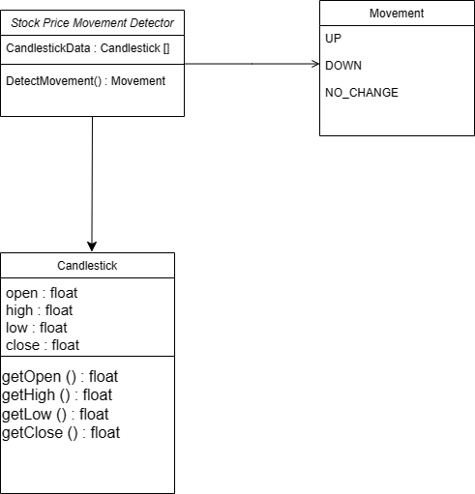
Class Diagram

Slide 19
Use-Case Diagram
user
Request for stock price prediction
Change settings and maintain logs
Logs
Change settings

Slide 20
Sequence Diagram
User
Backend
Dataset
Request for stock prediction
Request for data
Historical data
Predicted Price
Show Result

Slide 21
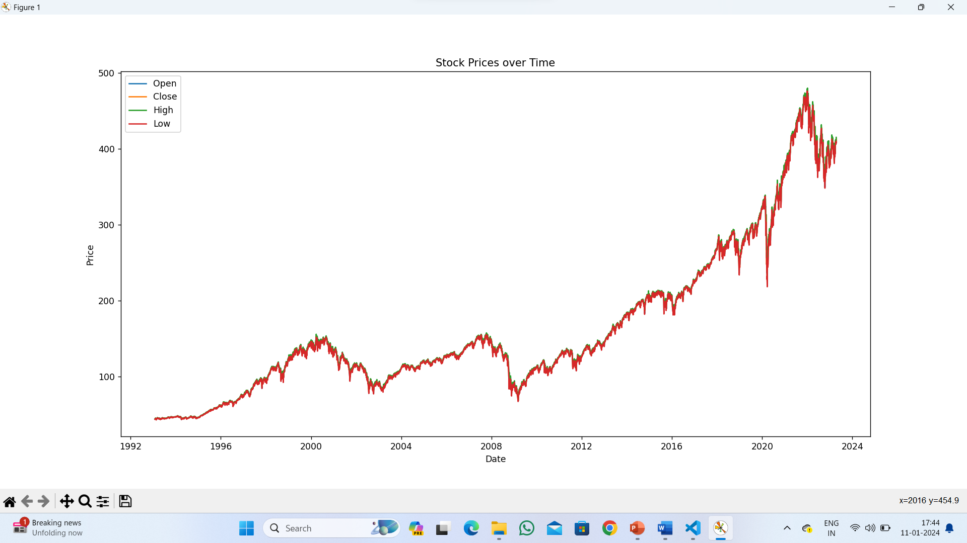
Output Screens
Scatter plot

Slide 22
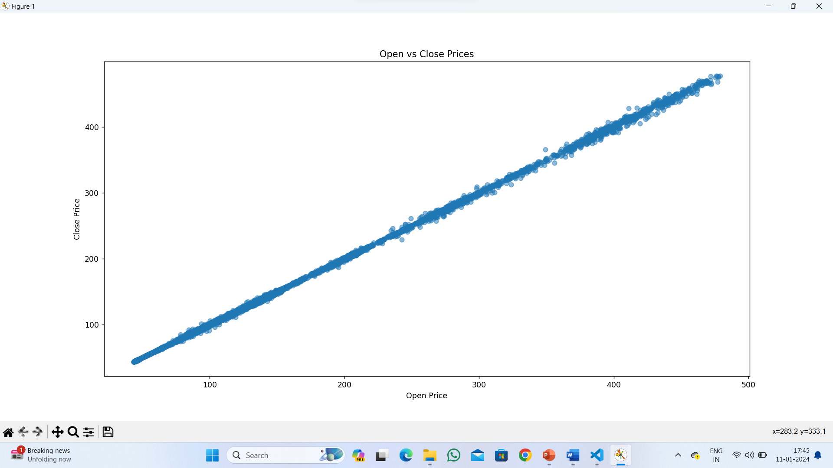
Line plot

Slide 23
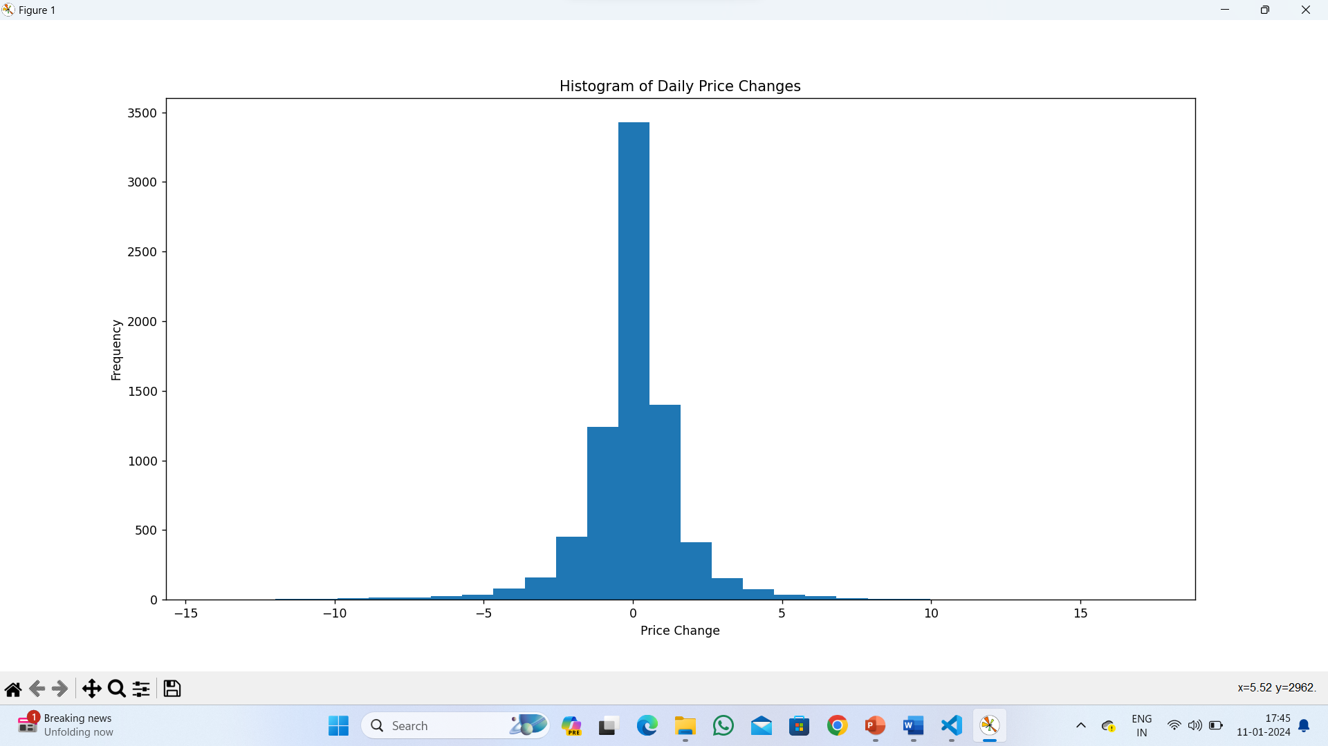
Price change

Slide 24
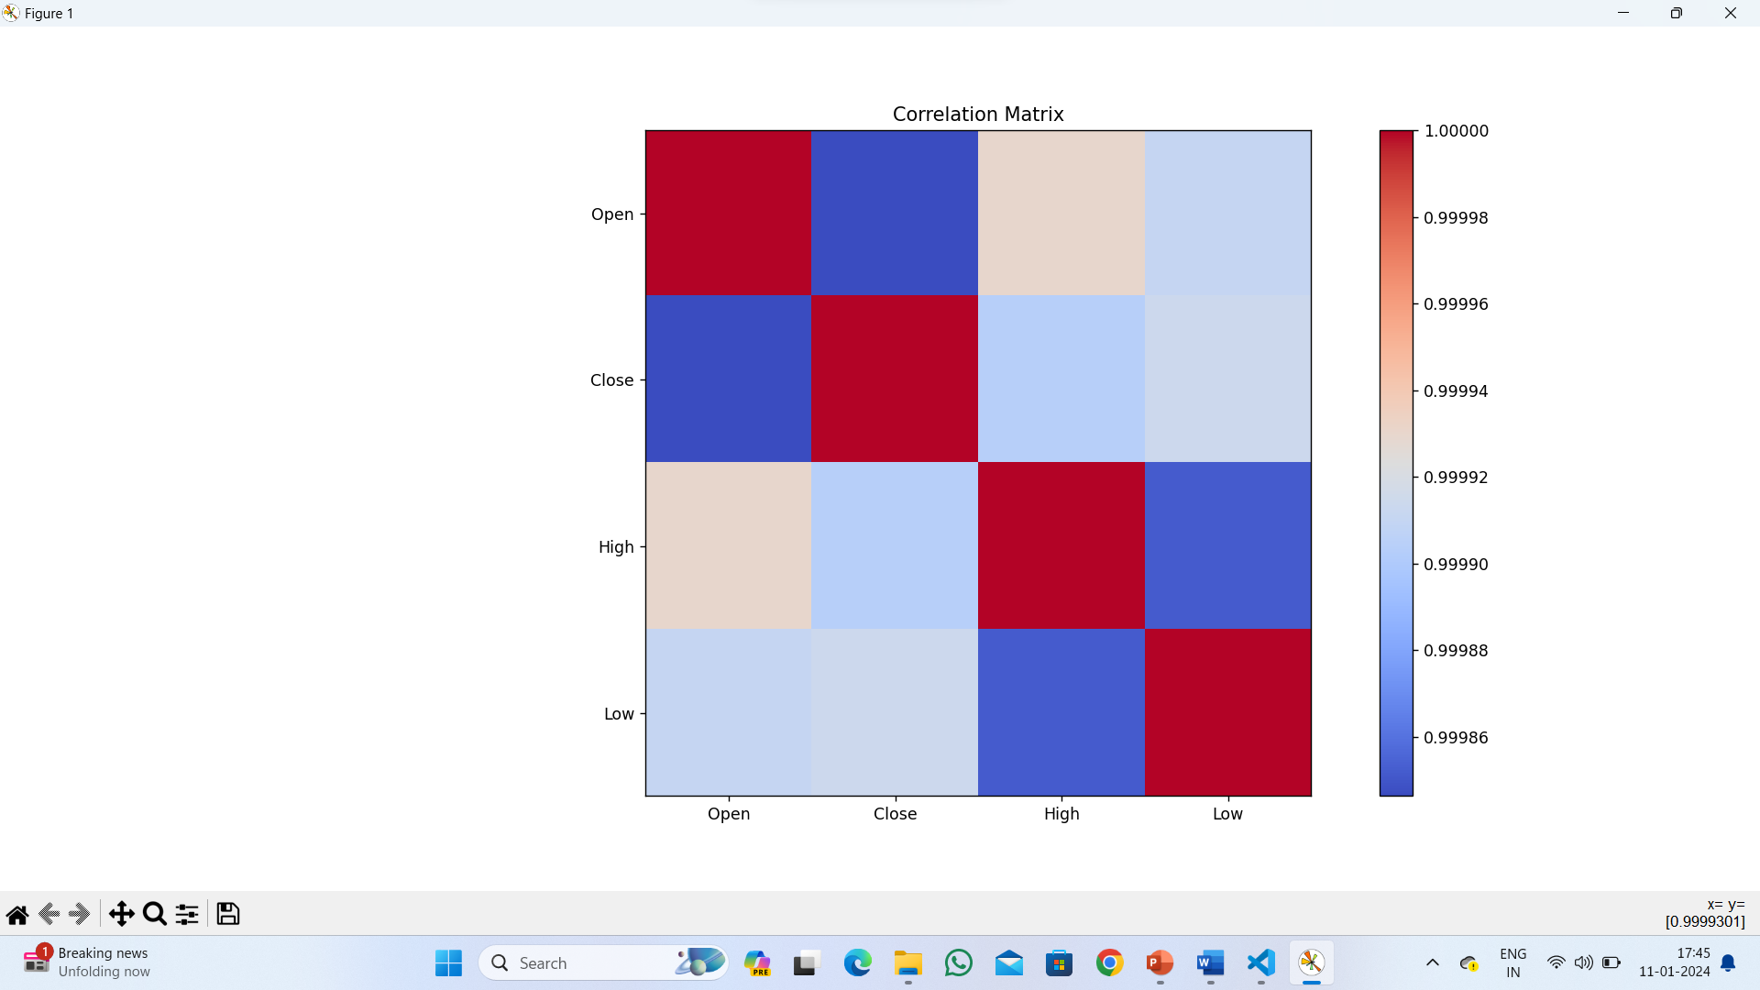
Correlation matrix

Slide 25
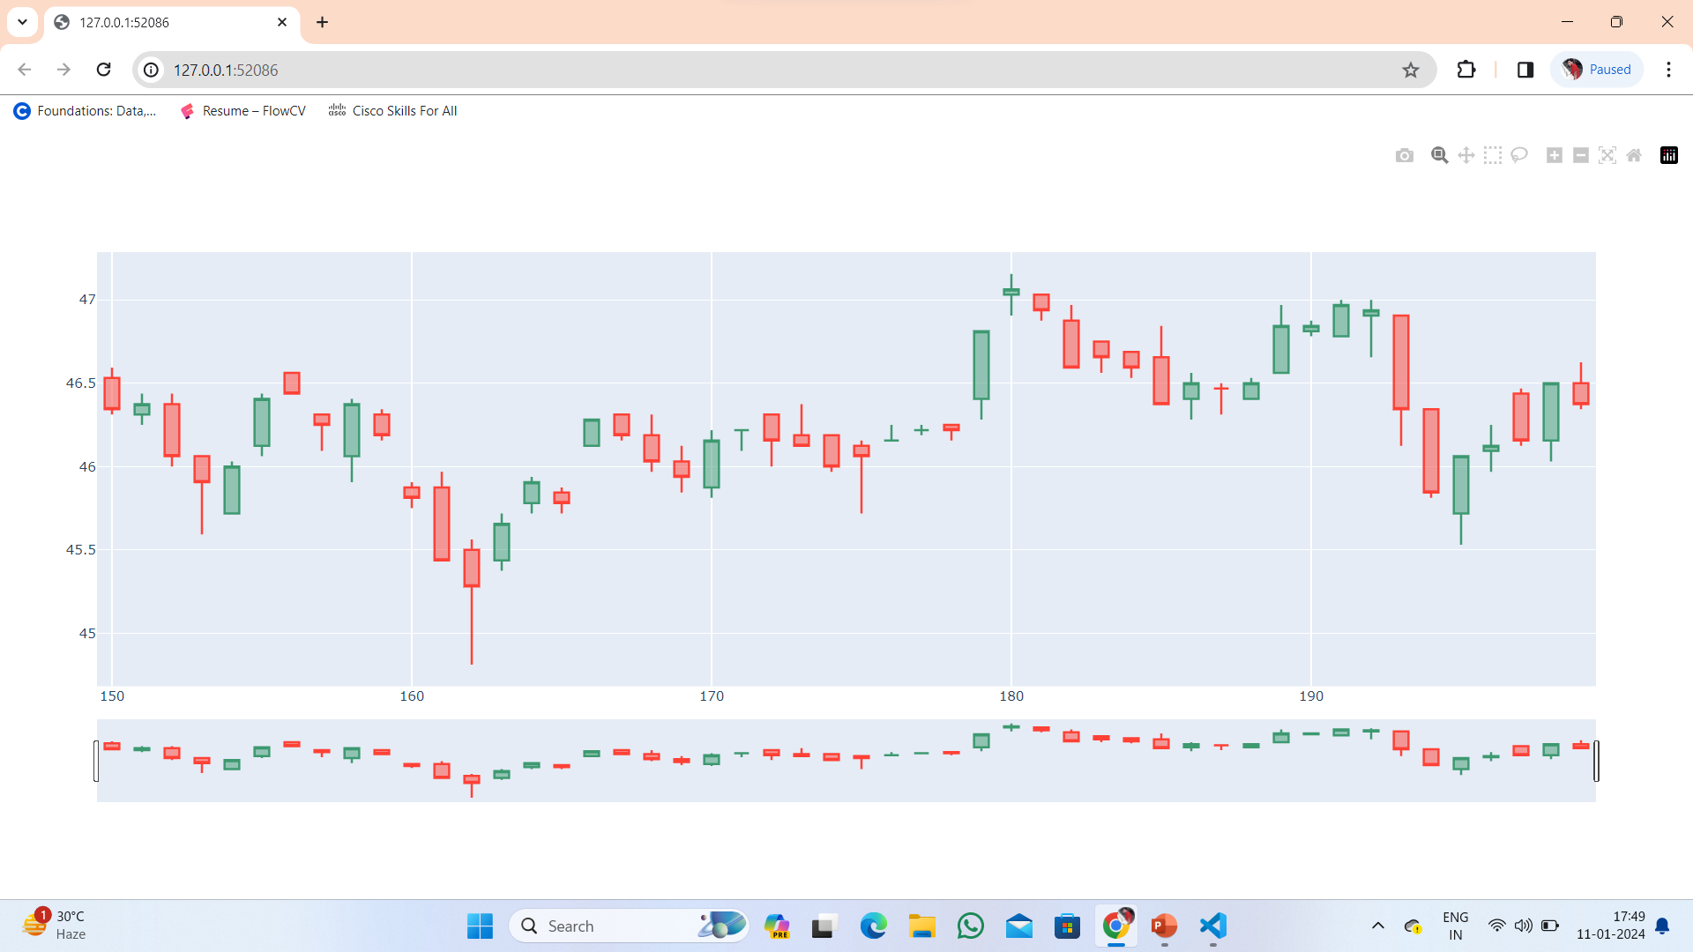
Candlestick patterns

Slide 26
About our Application
Stock price movement detection using candlestick patterns is a widely explored approach in financial markets. Candlestick patterns offer a visual representation of price action and can provide valuable insights into potential price movements. While candlestick patterns offer valuable insights into stock price movements, the successful implementation of a system for price movement detection using these patterns requires a holistic approach. It involves accurate pattern recognition, machine learning modeling, risk management, and continuous improvement to adapt to the ever-changing landscape of financial markets. Furthermore, it's essential to remember that no system can predict stock prices with absolute certainty, and a well-balanced investment approach should consider diversification and risk management alongside predictive techniques.

Slide 27
Conclusion
In conclusion, the utilization of candlestick patterns as part of a comprehensive technical analysis strategy can potentially enhance the accuracy of stock price movement predictions.
By combining candlestick patterns with other technical indicators, fundamental analysis, and risk management strategies, traders and investors can make more informed decisions and increase the chances of successful stock trading outcomes.

Slide 28
Future Scope
The main idea behind stock price prediction is to analyze the available information from the stock market in order to effectively predict future trends which can increase profit. Stock trend prediction techniques play a crucial role to bring more people into market and encourage markets as a whole. Fundamental analysis involves analyzing a company’s financial data to determine the fair value of the company, and to forecast future stock value. Because of this analyzing process, most investors believe that fundamental analysis is mainly suitable for long-term prediction.

Slide 29
Thank you
KATTA SHIVANI 20N31A6927
L. SREENIVAS REDDY 20N31A6933
Y. SUDHARSHAN REDDY 20N31A6959

